Slide 1
Monitor Based Convergence Control Toolkit
Subodh Deodhar
Davide Frigerio

Slide 2
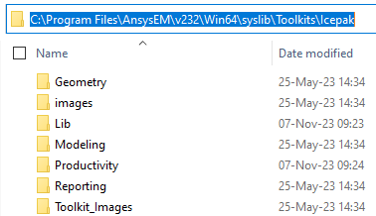
Toolkit install
The toolkit is provided with two files:
Monitor_Based_Convergence_Control.dll
Monitor_Based_Convergence_Control.py
The .dll file should be placed in C:\Program Files\AnsysEM\v232\Win64\syslib\Toolkits\Icepak\Lib
The .py file should be placed in C:\Program Files\AnsysEM\v232\Win64\syslib\Toolkits\Icepak\Lib

Slide 3
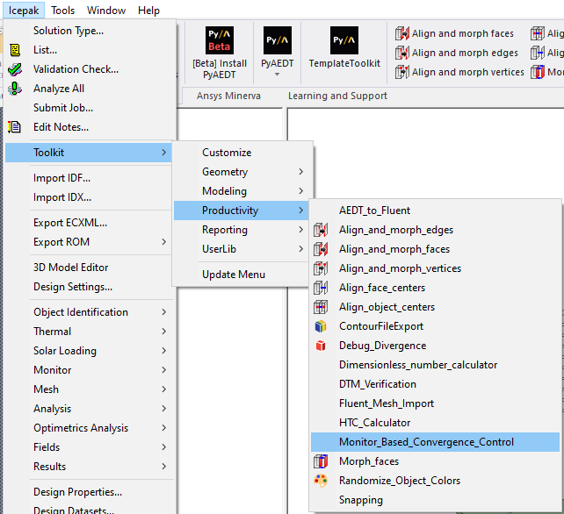
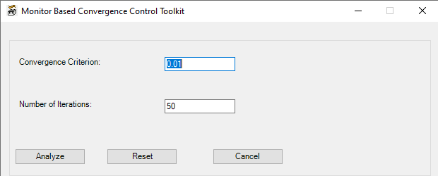
Toolkit usage
The toolkit should be used in place of the “analyze” command
It can be launched from
Icepak -> Toolkit -> Productivity -> Monitor_Based_Convergence_Control
The following inputs are required:
Convergence Criterion: the max relative change allowed for the monitors
Number of Iterations: the number of consecutive iterations over which the criterion is evaluated

Slide 4
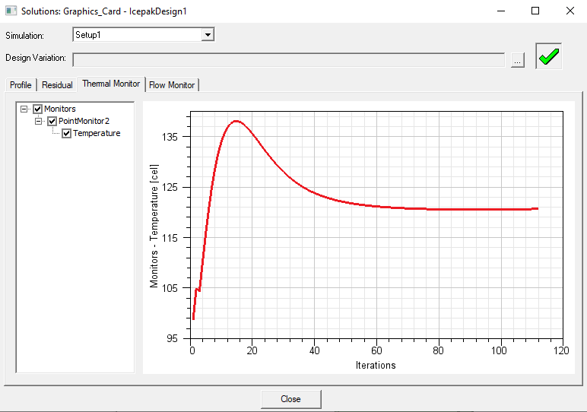
Toolkit usage
The toolkit will introduce the same convergence criterion on all the monitors set in the model
“Analyze” button will start the simulation
The simulation will stop when all the convergence criteria on monitors AND residuals are met

Slide 5
Background
The toolkit leverages the “Convergence conditions” feature of the Fluent solver. More information are available here: Convergence Conditions
Limitations:
Two way coupling is not supported

